Slide 1
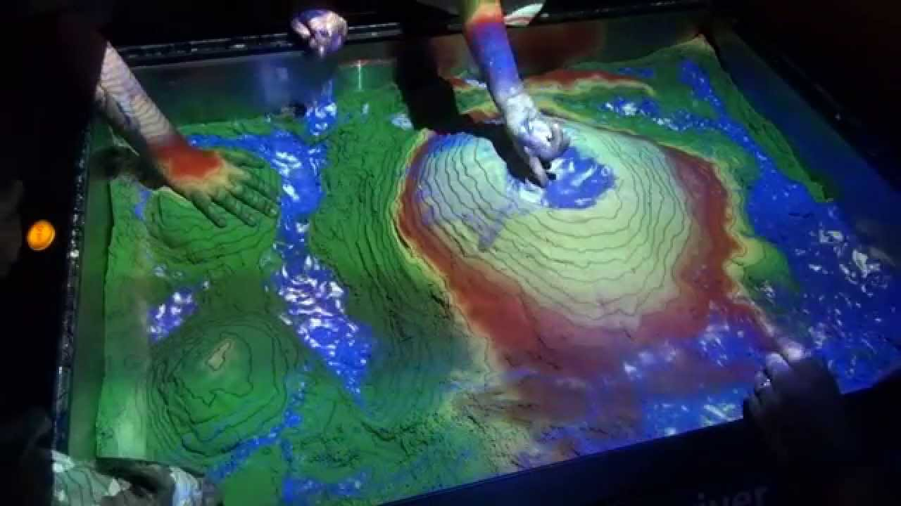

McNeese Augmented Reality Sandbox
Erin Bryson, Steven Dabelow, Andrew Galloway, Pramod Gobburi, Samantha Gunnell, Jason Rowland, Tyler Spears, Wendy Tygrett
College of Engineering and Computer Science, McNeese State University
What Is It?
How It Works
Hardware, Software, & Calibration
The augmented reality sandbox utilizes three-dimensional visualization applications that were originally designed by researchers at University of California, Davis.
The sandbox allows users to create topography models augmented in real-time with elevation color maps, simulated water, and topographical contour lines by shaping the sand. Its goal is to aid in teaching earth science concepts.
The users can place their open hand to create virtual rain clouds, which simulate the flow of water over sand using realistic water simulations.
Contour lines and colors may be adjusted to convey different topography aspects. Default contour lines and colors were chosen to show how elevation changes relate to hydrologic processes.
HARDWARE:
A computer with a high-end graphics card (AMD/ATI Radeon or Nvidia GeForce)
Microsoft Kinect 3D camera
A digital video projector with a 4:3 aspect ratio
A sandbox with a 4:3 aspect ratio
Sand
SOFTWARE:
Linux operating system
UC Davis’s AR Sandbox software packages
CALIBRATION:
Kinect intrinsic calibration
Kinect extrinsic calibration
Kinect and projector calibration
Goals
Understand how topographic maps and contour lines show the earth’s surface in 3D
Create a 3D topographical model
Understand how the earth’s surface changes under natural processes
Understand how water moves on earth’s surface and how its flow relates to land elevation and shape
References & Instructions
https://arsandbox.ucdavis.edu/about/ https://arsandbox.ucdavis.edu/instructions/
https://arsandbox.ucdavis.edu/info/technology-faqs/

